Slide 1
Early-Stage Cancer of the Esophagus and GE Junction

Slide 2

Anatomy
Food moves from the throat
$→$ esophagus
$→$ stomach
$→$ small bowel (jejunum)

Slide 3
Types of Esophageal Cancer
There are two common types of esophageal cancer
Adenocarcinoma
Squamous Cell Carcinoma
In many ways, these to different types of esophageal cancer behave the same.
We will see later in this video, however, that the treatment can be different depending upon whether the cancer is adenocarcinoma or squamous cell carcinoma.

Slide 4
Cancer Staging
Staging refers to the tests to determine
How large is the tumor?
Has there been spread to lymph nodes?
Has it spread to other parts of the body?
Treatment options depend upont the cancer stage

Slide 5
Esophageal Cancer Staging
T = Tumor - How deep has cancer grown into the wall of the esophagus?
N = Nodes - Has cancer spread to the lymph nodes?
M = Metastasis - Has the cancer spread to other parts of the body? lungs or liver?

Slide 6
Layers of the Wall of the Esophagus
Mucosa - Inner layer
Muscle Wall (muscularis)
Lymph nodes located in fat outside the muscle

Slide 7
Early Stage Cancers
Cancers start on the very inside of the layer called the mucosa

Slide 8
Locally-advanced Cancers
Over time, cancers can grow into the muscular wall

Slide 9
Lymph Nodes
In some cases, cancer cells can break off from the main tumor and spread to lymph nodes

Slide 10

T Stage
Cancers are categorized based upon the thickness of the tumor, known as the T stage

Slide 11

N Stage
Cancers are categorized by whether there is spread to the lymph nodes.
N0 cancers have not spread to the lymph nodes
N1 cancers have spread to the lymph nodes.

Slide 12

M Stage
Some cancers can also spread from the esophagus to the lungs or liver
M0 cancers have not spread to other parts of the body
N1 cancers have spread to other parts of the body such as lungs or liver

Slide 13

PET scan
A PET scan is similar to a CT scan, and uses a small amount of tracer to light up areas of cancer.

Slide 14

Endoscopic Ultrasound
Endoscopic ultrasound (EUS) is a procedure similar to upper endoscopy (EGD) which has an ultrasound probe at the bottom of the scope. This allows measuring the thickness of the cancer. Endoscopic ultrasound can help determine the T stage of the cancer.

Slide 15

Laparoscopy
Some esophageal cancers can spread inside the abdominal cavity. These areas of spread can be very small, as small as a grain of rice.
In order to detect spread within the abdominal cavity, a proceduce called a laparoscopy can be performed in some some patients.

Slide 16
Laparoscopy
A laparoscopy is performed under a general anesthetic.
Several incisions 1/4” long
A telescope is inserted to look inside the abdominal cavity.
Biopsies can be performed.

Slide 17
Treatment Plans
Superficial (T1) $⇒$ Endoscopic Therapy
Localized (T1b/T2) $⇒$ Surgery
Locally-advanced (T3/N1) $⇒$ Chemo $±$ Radiation $→$Surgery
Metastatic (M1) $⇒$ Chemotherapy

Slide 18
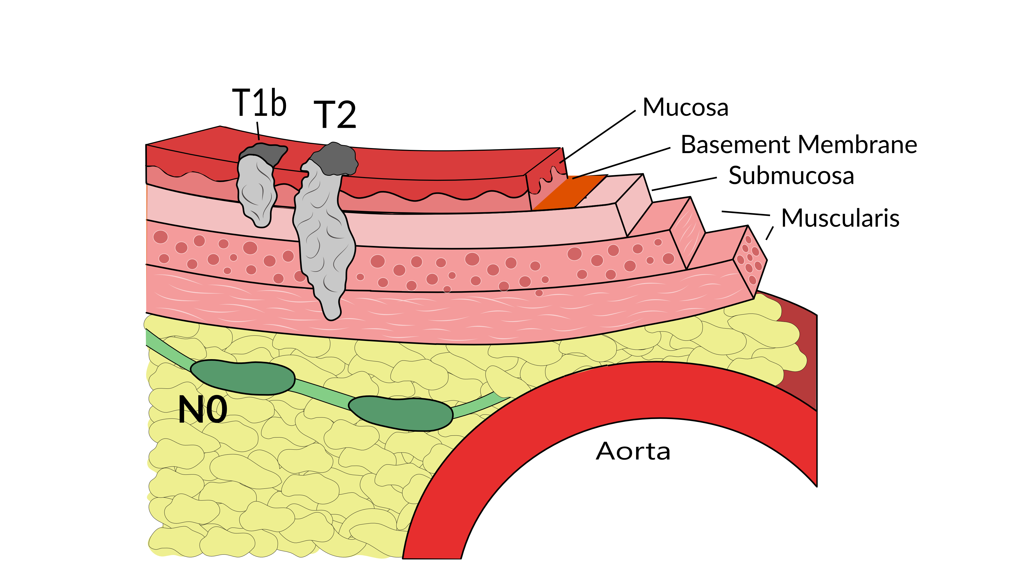
Localized Cancers
Patients with locally-advanced esophageal cancer have smaller tumors which have not invaded all the way throug the muscle wall and are too large to remove by endoscopic therapy

Slide 19
Localized Cancers
Localized cancers rarely spread to the lymph nodes, which means that surgery alone can often remove the cancer completely.
Localized cancers are less likely to need chemotherapy or radiation because the cancer is localized to the wall of the esophagus.

Slide 20
Localized Cancers
Localized cancers are not very common, because most people don’t know that they have esophageal cancer until they have difficulty eating. The majority of patients who have difficulty eating have a T3 tumor and usually need either chemotherapy and/or radiation to prevent recurrences

Slide 21
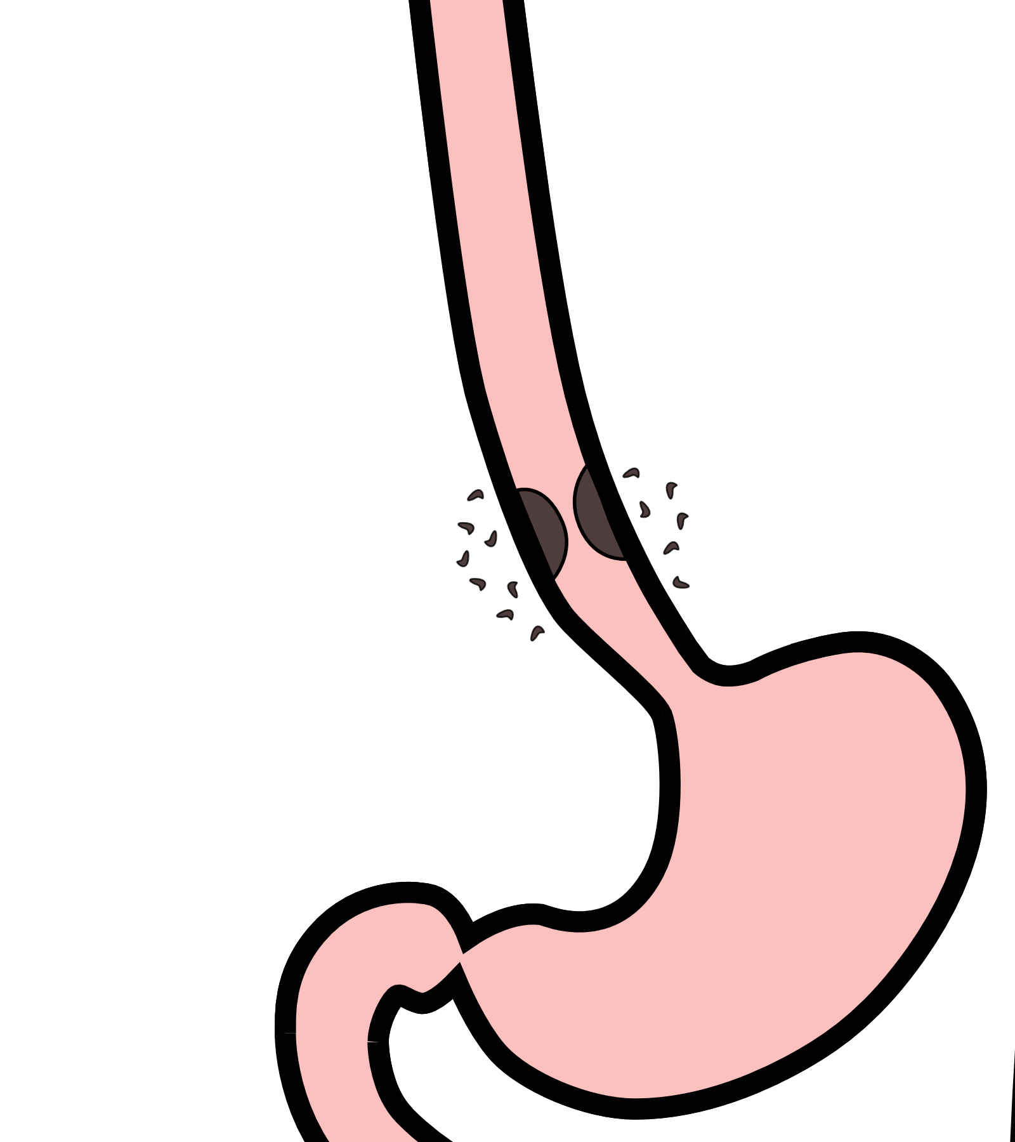
Diagnosis
Localized cancers are generally diagnosed with a combination of endoscopic ultrasound and PET scan.
Endoscopic ultrasound can determine the T stage
PET scan can look at the nearby lymph nodes

Slide 22
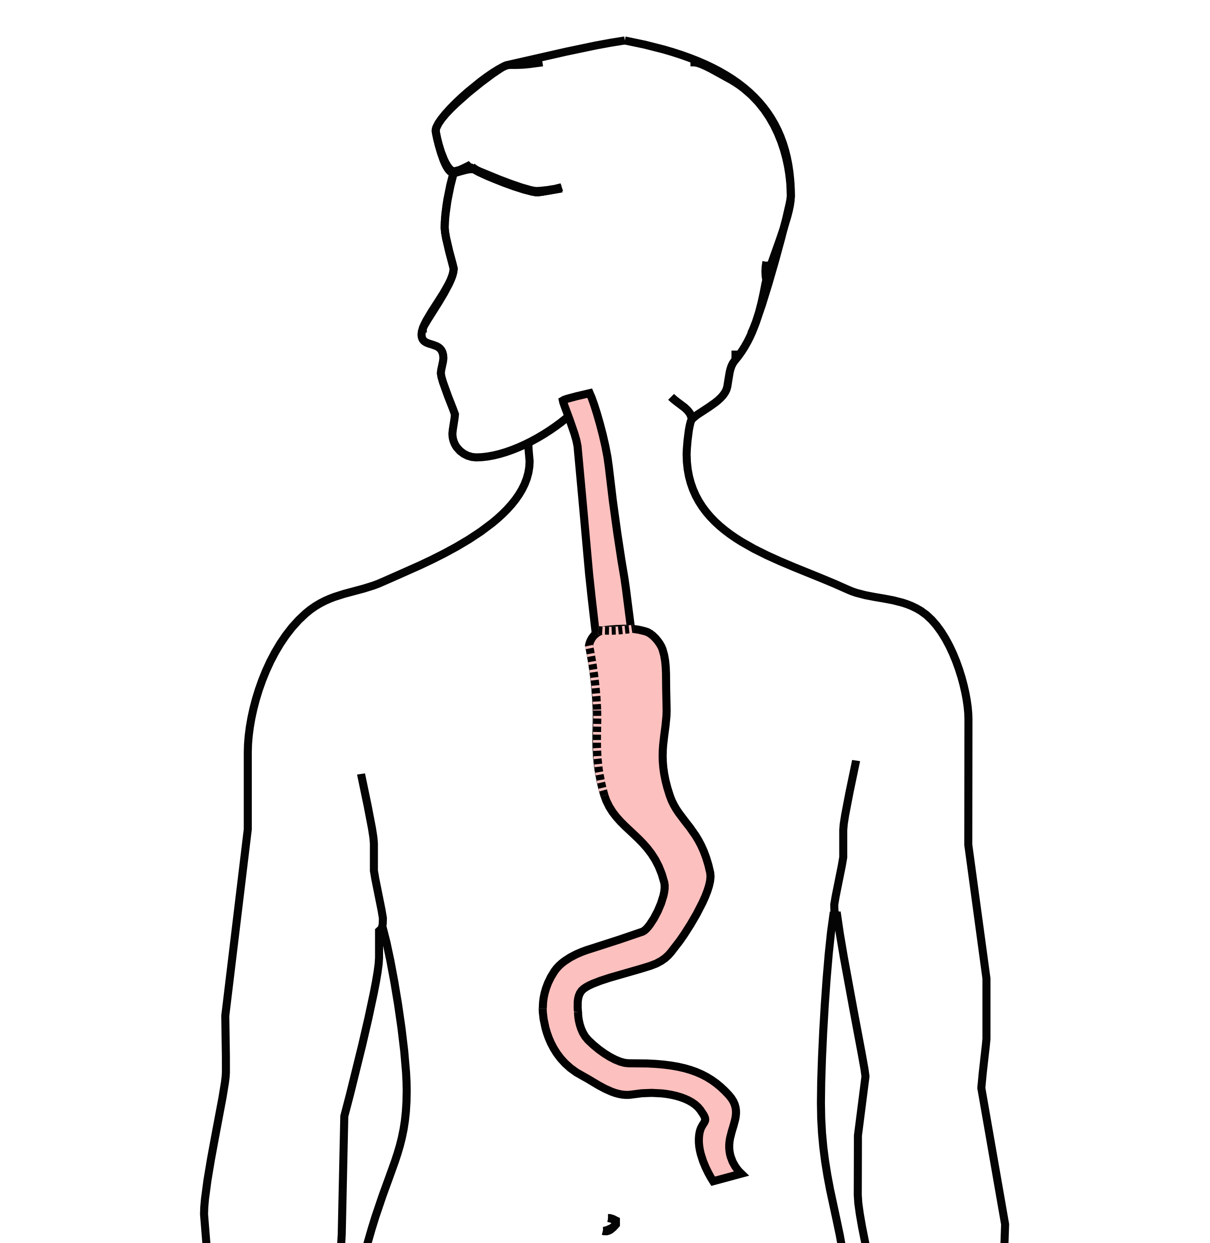
Surgery
Surgery to remove the esophagus is frequently done for localized esophageal cancers

Slide 23
Surgery for Localized Esophageal Cancer
If surgery is performed, the cancer in the esophagus is examined by the pathologist to confirm the precise thickness of the tumor and its T stage
About 25% of the time, the pathologist finds that the tumor is actually T3 or N1, in which case chemotherapy and/or radiation is needed after surgery.
On the other hand, in 75% of cases surgery is all the therapy that is required and there is no need for chemotherapy and/or radiation

Slide 24
Chemotherapy + Radiation for Localized Esophageal Cancer
An alternative to surgery is to start with a combination of chemotherapy and radiation therapy.
We know that in some cases, chemotherapy + radiation can be curative for esophageal cancer without the need for surgery.
For adenocarcicnoma, about 25% of cases are cured with chemotherapy + radiation
For squmaous cell carcinoma, about 40% of cases are cured with chemotherapy + radiation

Slide 25
Followup after Chemotherapy + Radiation
The challenge here is that it’s difficult to know right away whether chemotherapy + radiation has been effective for esophageal cancer.
In most cases, scans and upper endoscopy performed after chemotherapy + radiation show no signs of cancer, but only a minority of cases are actually cured.
In can take up to two years to know with certainty whether or not an esophageal cancer has been cured by chemotherapy + radiation.

Slide 26
Chemotherapy + Radiation CROSS Trial
Chemotherapy + Radiation $→$Surgery $⇒$ Longer Survival
Chemotherapy and radiation were given together over six weeks

Slide 27
Chemotherapy + Radiation CROSS Trial
A typical schedule for chemotherapy + radiation:
Chemotherapy once per week for six weeks
Radiation five days per week for six weeks (28 treatments)
PET scan 4 weeks after the end of radiation
EGD every 3-6 months for 2 years
CT scan every 6-12 months

Slide 28
Chemotherapy + Radiation - Side Effects
Radiation kills cancer cells, but can also cause irritation of the lining of the esophagus.
This can make swallowing more challenging the last two weeks of therapy.
A feeding tube is sometimes needed to help with hydration and nutrition.

Slide 29
Chemotherapy
Chemotherapy drugs are administered intravenously.
There are several options for intravenous access:
Peripheral IVs in the hand
PICC line (Peripheral Inserted Central Catheter)
Central Venous Port

Slide 30
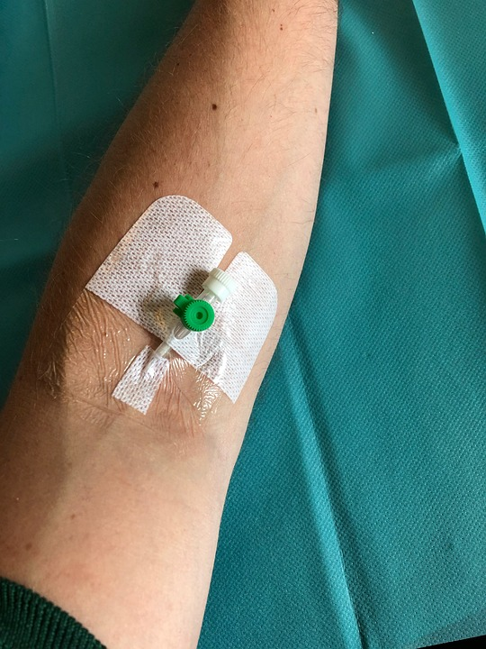
Peripheral IVs
Some patients can be treated with an intravenous line placed in the hand or arm for each dose of chemotherapy. The catheter is placed at the beginning of each dose and removed that day.

Slide 31
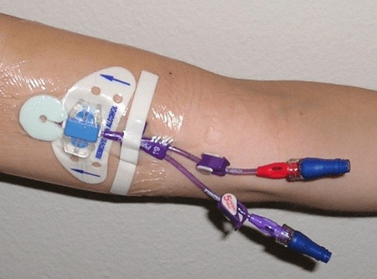
PICC Lines
A PICC line is placed in Radiology and stays in place during the treatment course

Slide 32
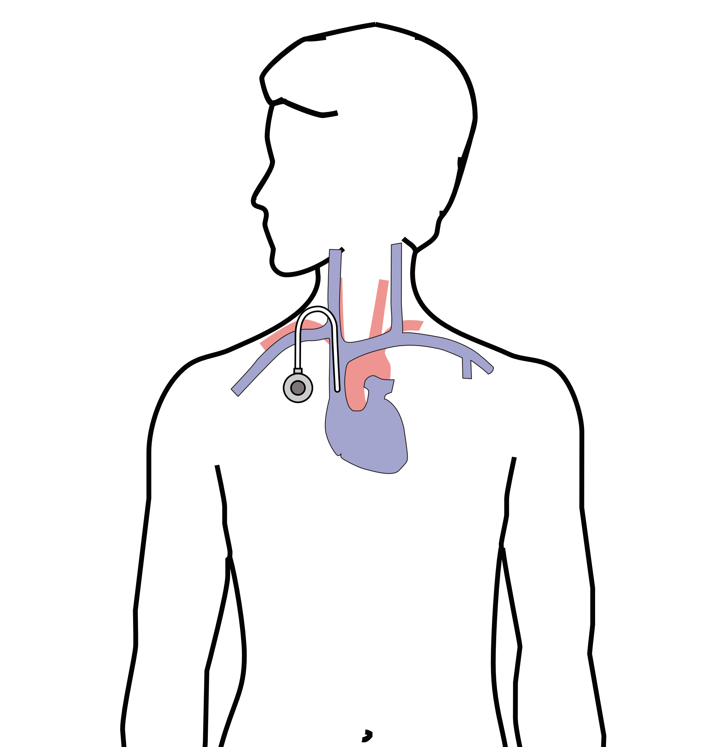
Central Venous Port
A central venous port is an implantable device that makes the administration of chemotherapy easier

Slide 33
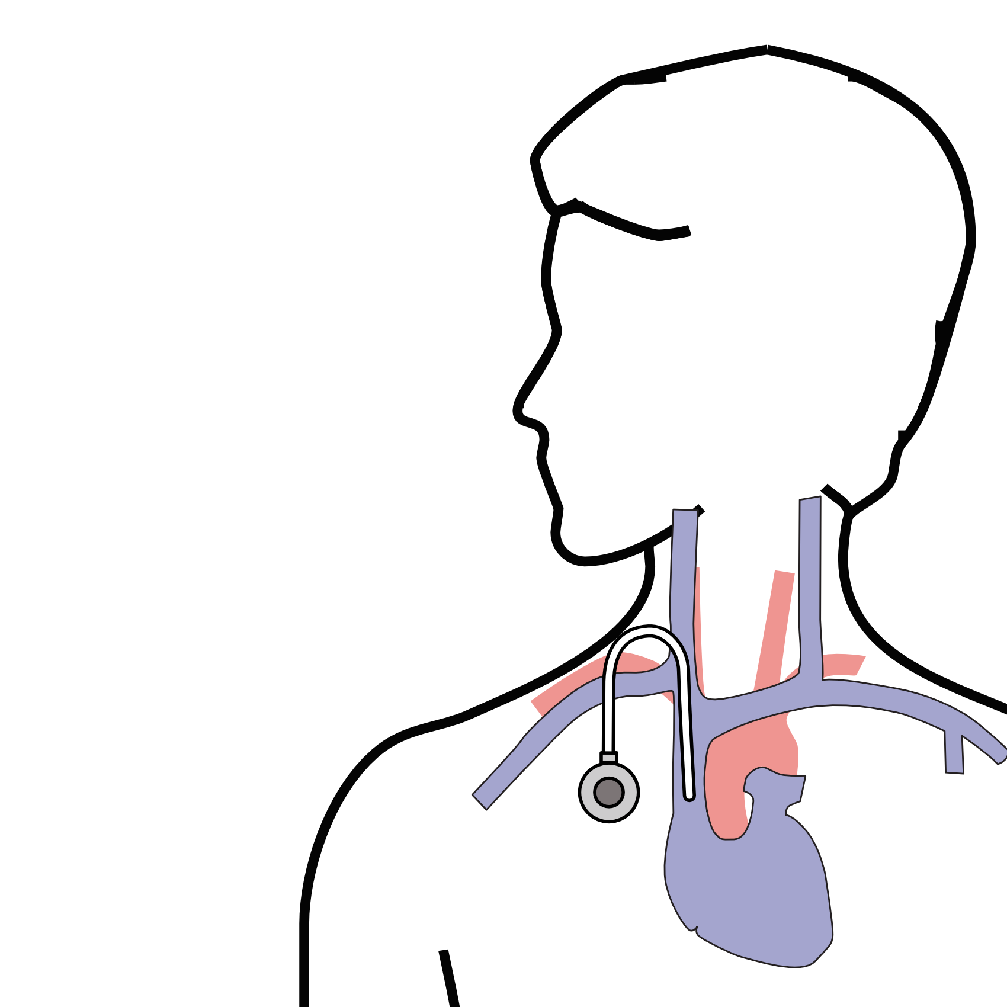
Central Venous Port
A central venous port is typically placed underneath the skin below the right collarbone

Slide 34
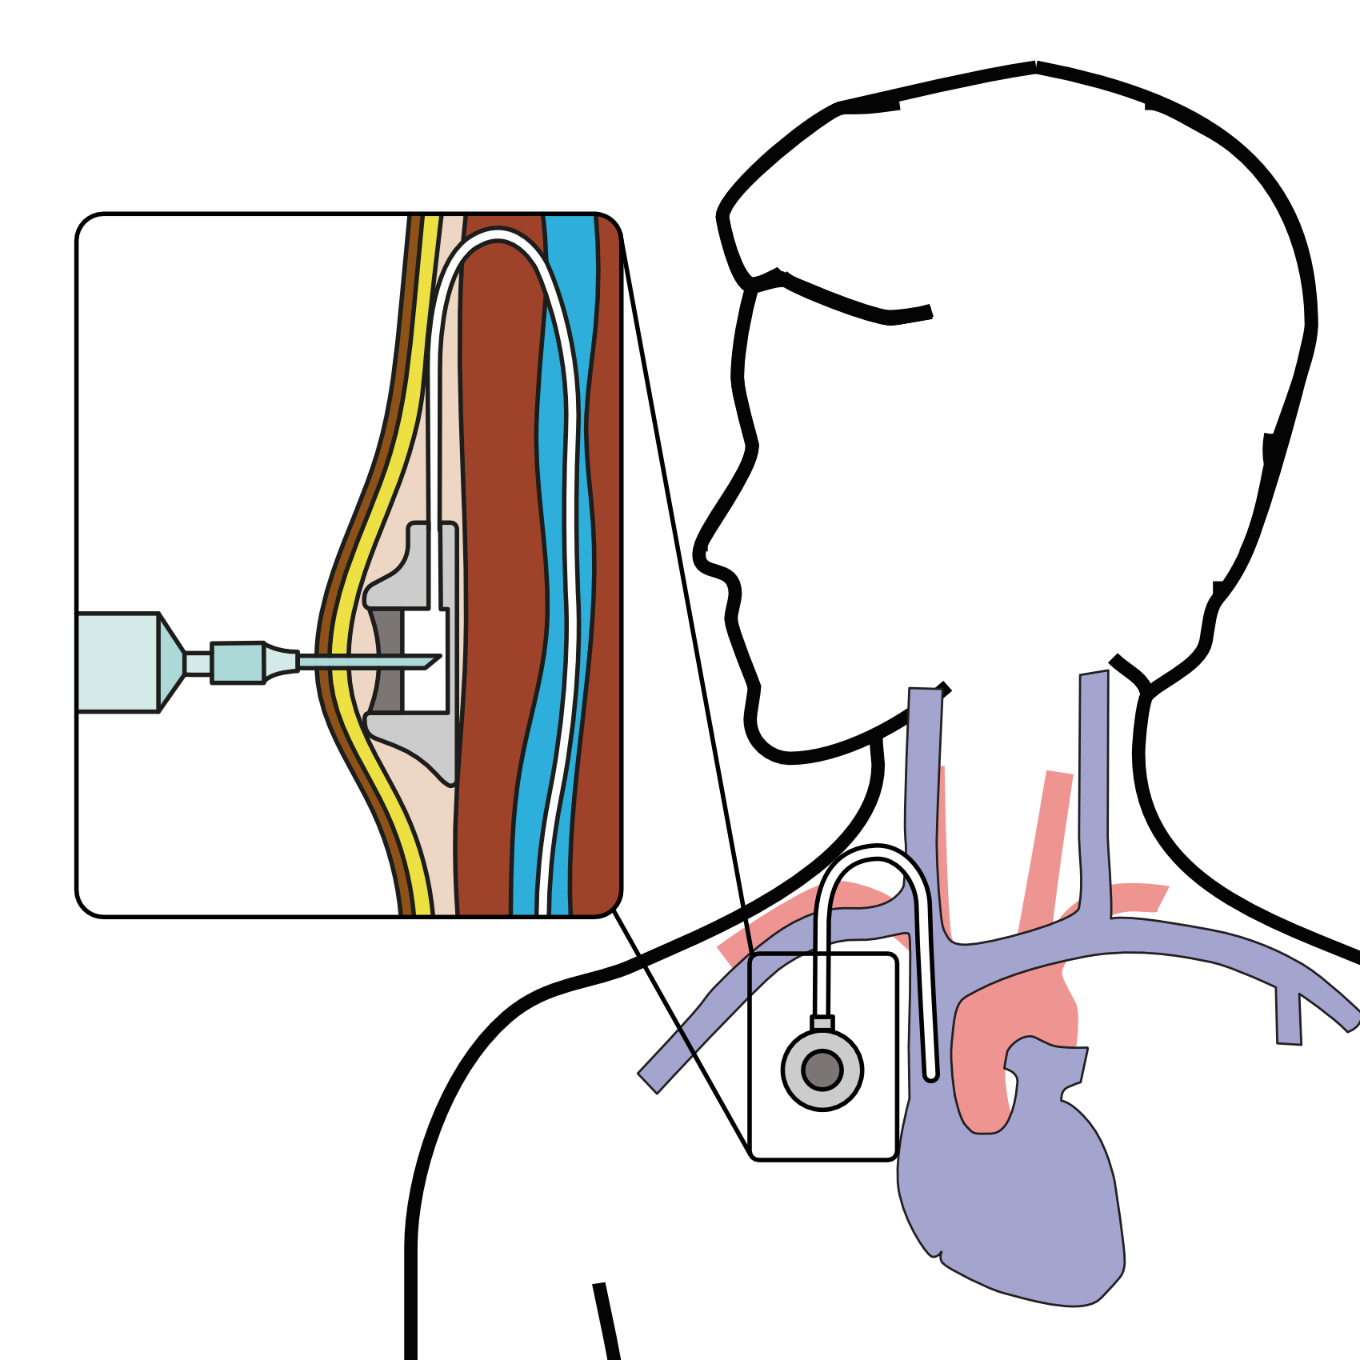
Central Venous Port
When it is time for chemotherapy, a needle is inserted through the skin into the port

Slide 35
Restaging
CT or PET scan will be performed after preoperative therapy

Slide 36
Surgery
Surgery Slideshow

